Slide 1

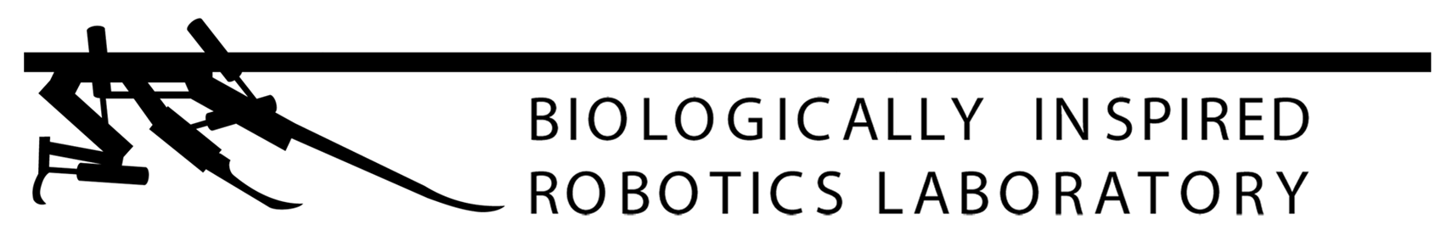


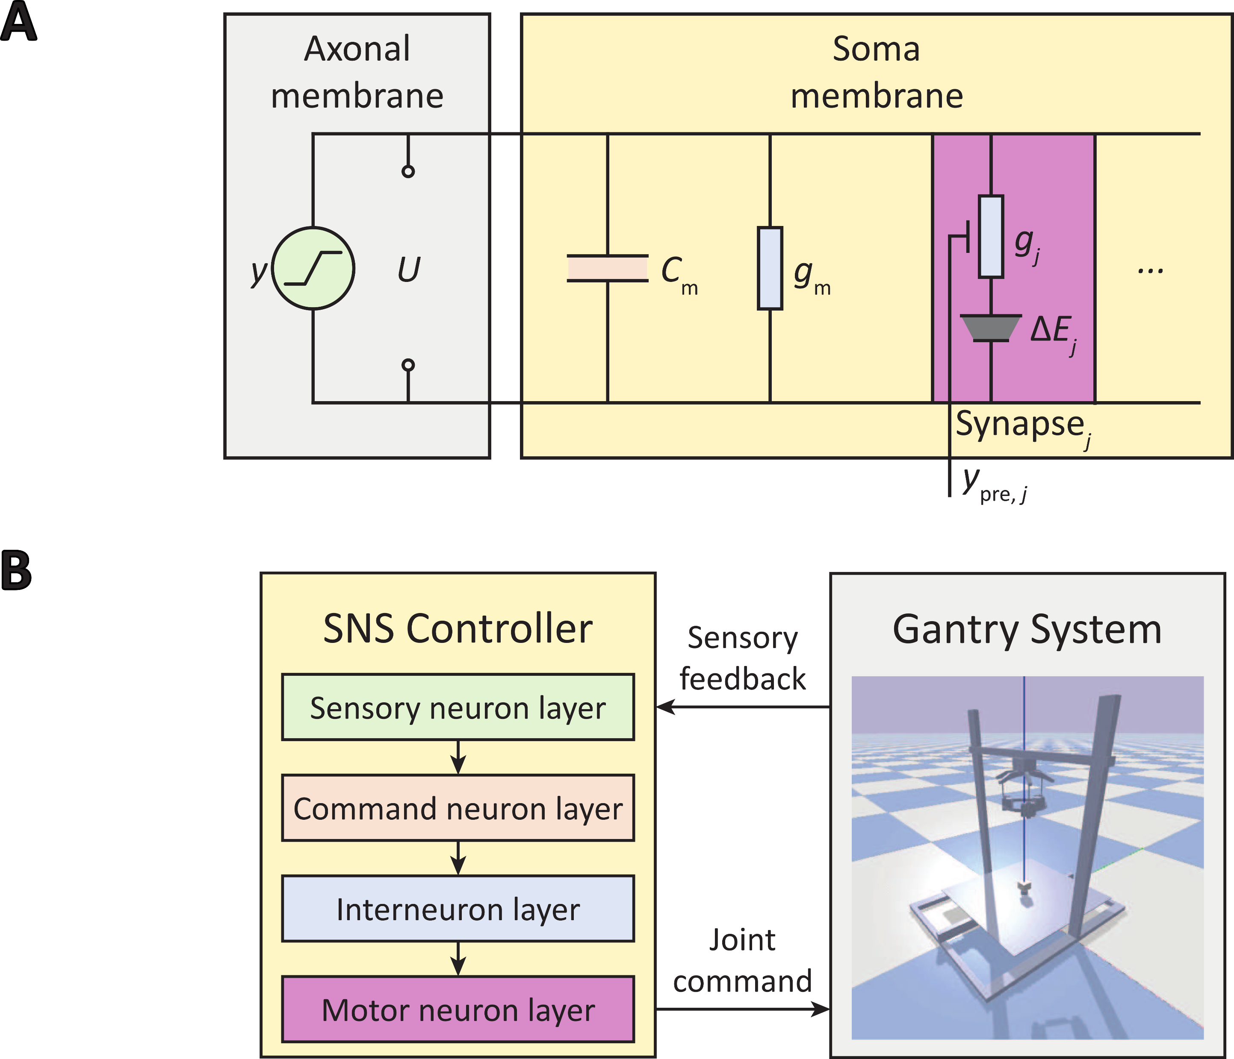
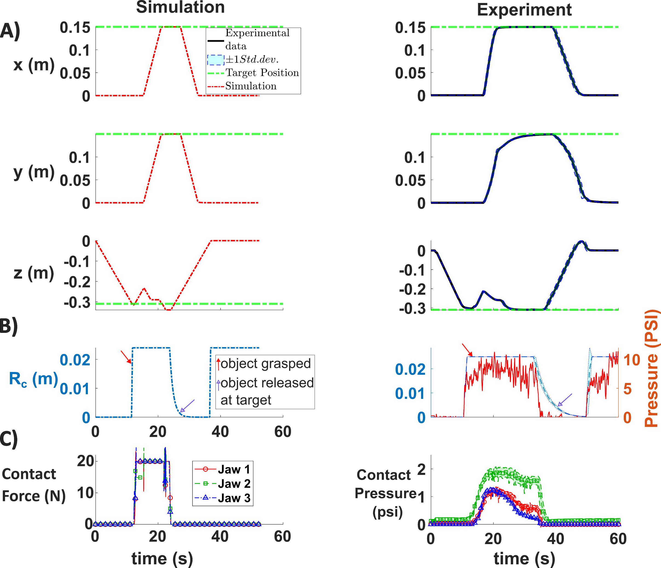
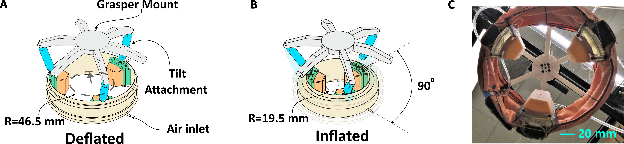
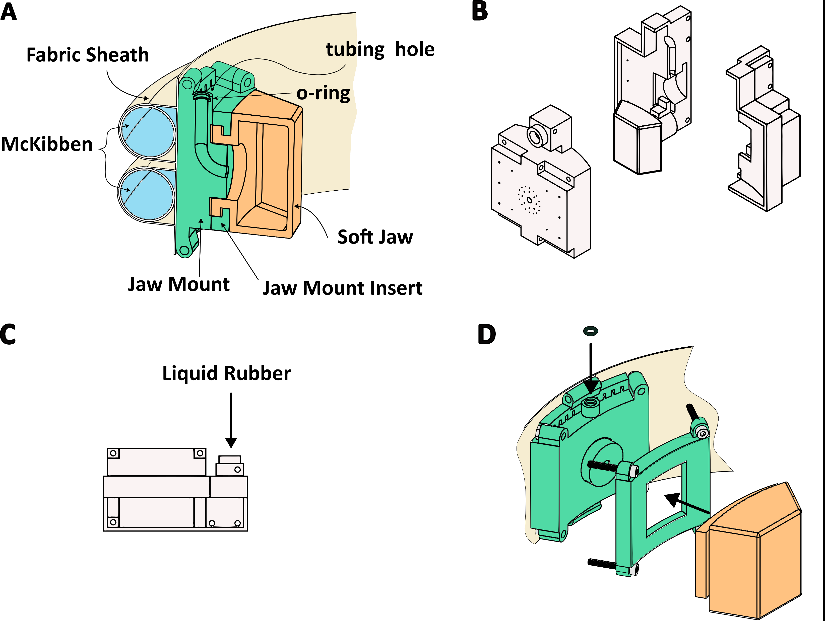
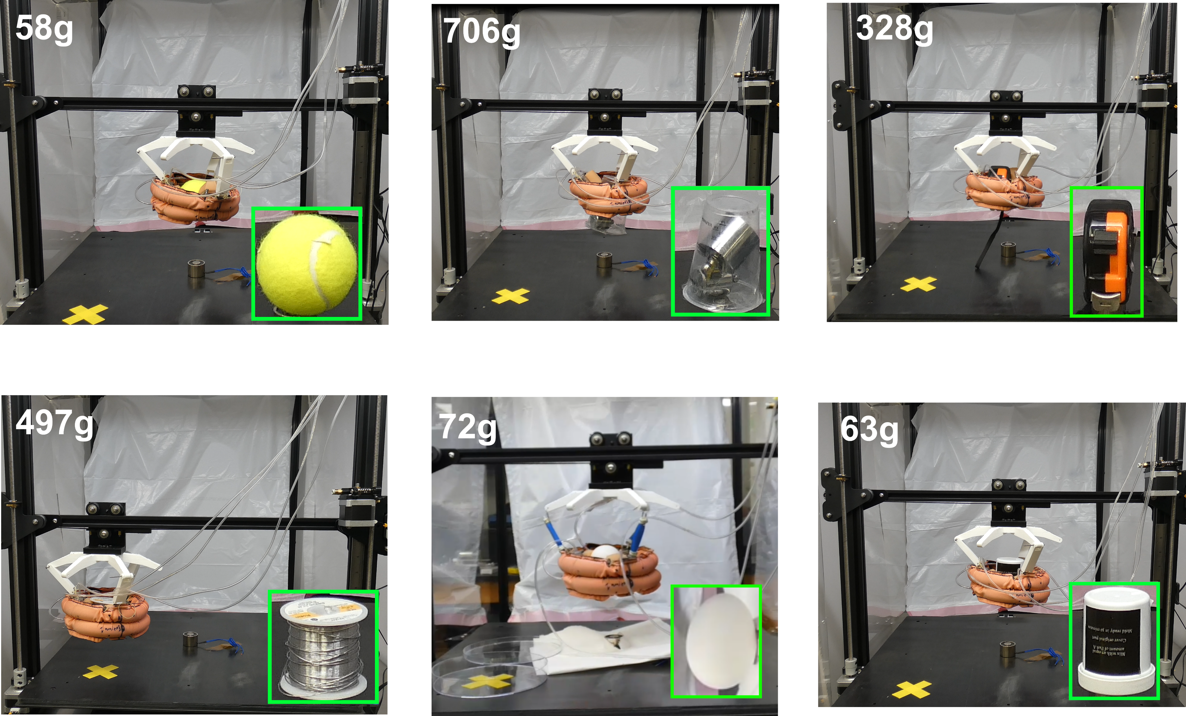
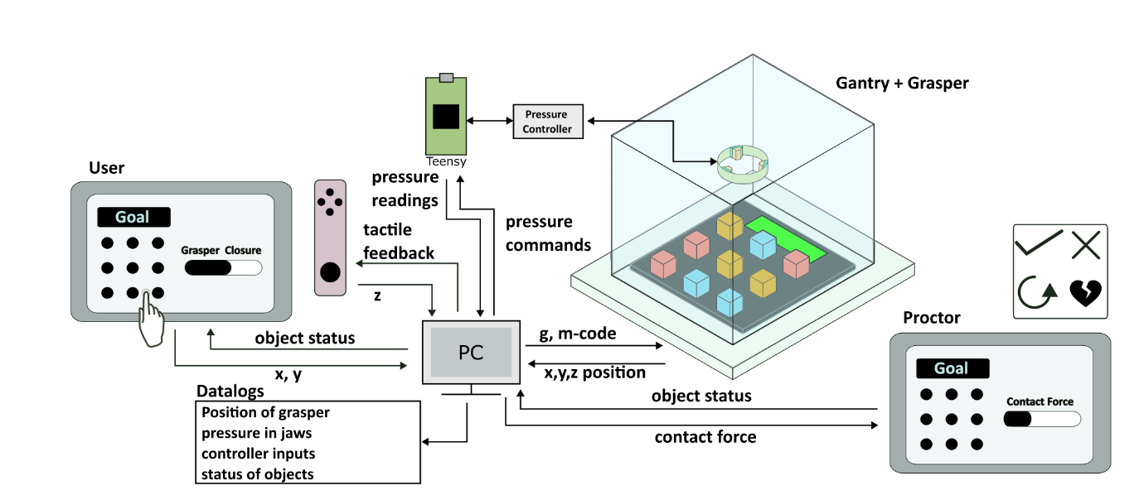
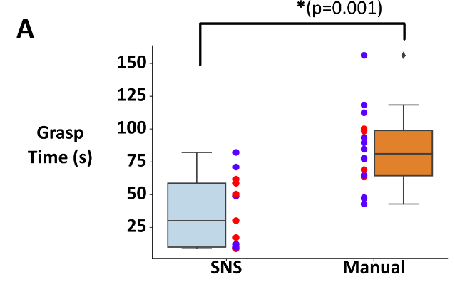
Synthetic Nervous System Control of a Bioinspired Soft Grasper for Pick-and-Place Manipulation
Ravesh Sukhnandan¹, Yanjun Li⁴, Yu Wang¹, Anaya Bhammar¹, Kevin Dai¹, Michael Bennington¹, Hillel J. Chiel^{5,6,7}, Roger D. Quinn⁴, Victoria A. Webster-Wood^{1,2,3}
Carnegie Mellon University: 1) Mechanical Engineering, 2) Biomedical Engineering, 3) McGowan Institute for Regenerative Medicine
Biohybrid and Organic Robotics Group
Case Western Reserve University: 4) Mechanical Engineering, 5) Biology, 6) Neurosciences, 7) Biomedical Engineering
Introduction
Synthetic Nervous System Controller
Results: Pick-and-Place Kinematics
Grasping and manipulating objects of various sizes, surface properties, and shapes remains challenging for robots.
Aplysia californica serves as inspiration for both the grasper’s physical morphology as well as the hierarchical neural controller
Fig. 1: A) Soft grasper in open state. B) Grasper in closed state. C) Manufactured soft grasper.
Grasper Design and Fabrication
Fig. 3: A Synthetic Nervous System (SNS) Controller is used to control the grasper and gantry platform to perform pick-and-place tasks. A) The SNS incorporates the dynamics of real neurons. B) The structure of the SNS controller is inspired by Aplysia’s hierarchical neural controller. The SNS controller receives sensory feedback of the position of the grasper and the changes in pressure at the pneumatic jaws due to contact.
Fig. 5: Comparison of simulation (left) vs. experimental (right kinematics, pressures and forces. A) The real robot took longer to execute the pick-and-place motion due to hardware limitations. B) Commanded radial position and C) contact forces and pressures followed expected trends.
Conclusions
The SNS was able to successfully control a soft grasper to perform the pick-and-place a variety of objects.
Results: Pick-and-Place Experiments
Future Work
Fig. 6: Human-in-the-loop grasping experiments, where users pick-and-place objects with and without shared control with the SNS. A) System Architecture. B) Preliminary results indicate that users complete the tasks significantly faster with SNS shared control than without.
Fig. 2: The grasper abstracts Aplysia’s ability to tune contact stiffness and envelop the grasped object using soft pneumatic jaws and circumferential McKibben actuators, respectively. A) Cross section of the soft grasper. B) The soft jaw is manufactured by first assembling a 3d-printed mold. C) A liquid urethane elastomer is then injected. D) The soft jaw is then assembled onto the rest of the grasper using 3d-printed inserts.
Fig. 4: Under SNS control, the grasper can grasp a variety of objects, up to a maximum tested mass of 706 g.
This work was supported in part by the National Science Foundation (NSF) grant no. FRR-2138873 and by a GEM fellowship.

